Slide 1

Algorithmic Discrimination in On-Demand Food-Delivery Platforms using Multi-Agent Reinforcement Learning
Presenter: Zijian Zhao
Ph.D. Student in Civil Engineering (Scientific Computation)
Ph.D. Qualifying Exam, December 2, 2025
Supervisor: Prof. Sen Li

Slide 2








Part I: Background of Algorithm Discrimination in Food-Delivery Markets

Slide 3
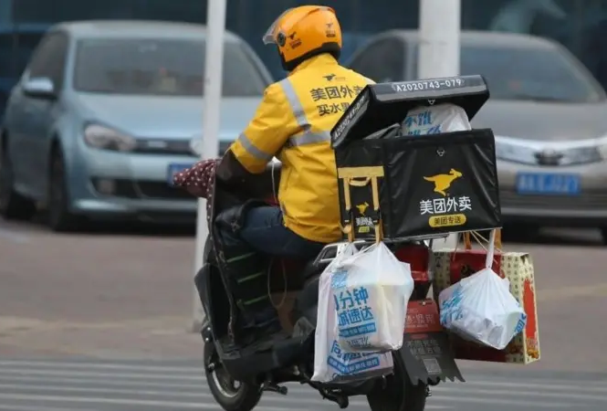
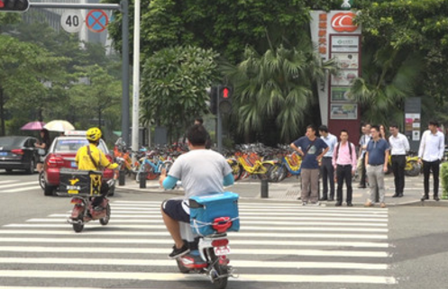

Background: Algorithm Discrimination in Food-Delivery Platforms
Learning algorithm in food-delivery platforms:
profit maximization: Platforms aim to achieve optimal control over couriers while offering the lowest payment.
overuse of privacy data: Platforms utilize personal data to differentiate between various types of couriers.
Discriminatory algorithmic labor management:
personalized payment: Couriers have varying expected salaries for the same work (referred to as ‘reservation value’) → violating principle of ‘equal pay for equal work’
dispatching preference: Couriers with high willingness to work present higher certainty and lower costs for platforms → prioritize couriers with more favorite working pattern
Couriers controlled by algorithms:

Slide 4



Background: Data Privacy Regulation (DPR)
Take GDPR (Europe) as an example:
Article 6.1.a : Data processing is lawful only when the data subject has provided consent for one or more specific purposes.
Article 7.2: Individuals have the right to withdraw consent at any time, and the process for withdrawal must be as simple as providing consent.
Basic principles of DPR:
data minimization
user content, individual control over personal information
GDPR
PIPL
CCPA

Slide 5
Research Questions
Research questions:
Q1: How does the discriminatory algorithm influence platforms and couriers? (Project 1)
Q2: How does data privacy regulation policy influence food delivery market? (Project 2)
Challenges:
The dispatching strategy and payment strategy of platforms are coupled. (Project 1)
Couriers' behaviors occur on different time scales: (Project 2)
long-term: decide whether to work on the platform and whether to share their personal information
short-term: determine whether to accept assigned orders
Complex interaction and training process between platform and couriers (Project 1&2)

Slide 6
Part II: Platform Modeling via Hybrid-Action MARL
Zijian Zhao, Sen Li*, "Discriminatory Order Assignment and Payment-Setting of On-Demand Food-Delivery Platforms: A Multi-Action and Multi-Agent Reinforcement Learning Framework" (under thrid-round review, Transportation Research Part E: Logistics and Transportation Review (TR_E))

Slide 7
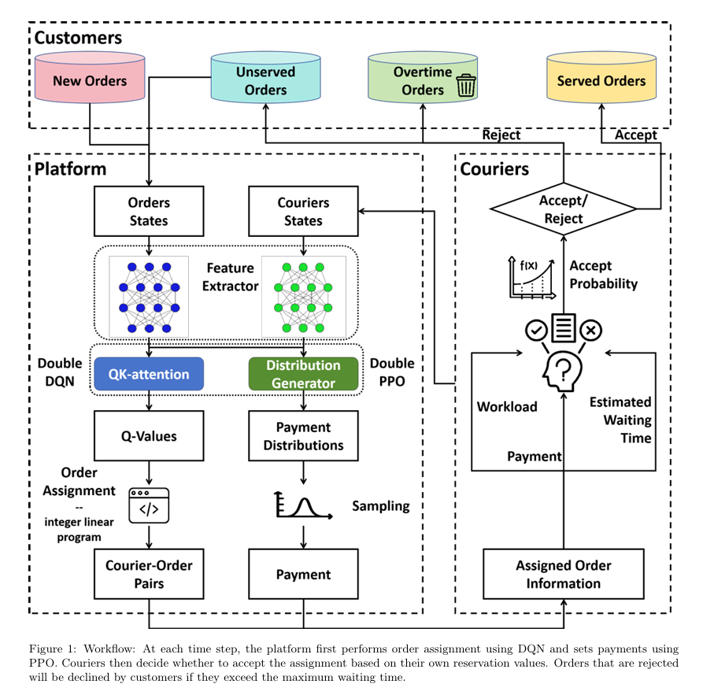

System Workflow
Platform：determine order assignment and payment setting
Couriers：determine whether to accept the assigned order based on payment and individual reservation value
Customers & Restaurants:
set orders at arbitrary times
cancel the order if not confirmed within a maximium time threshold

Slide 8
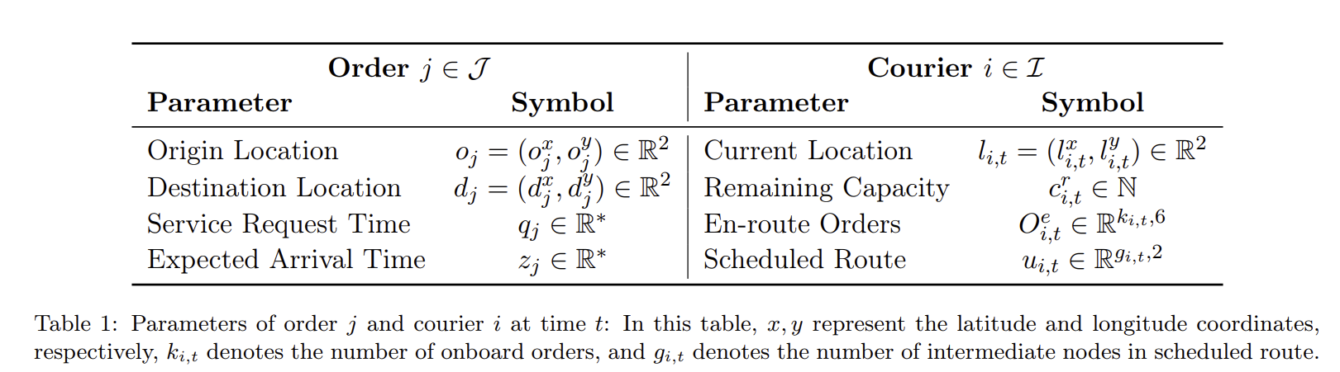
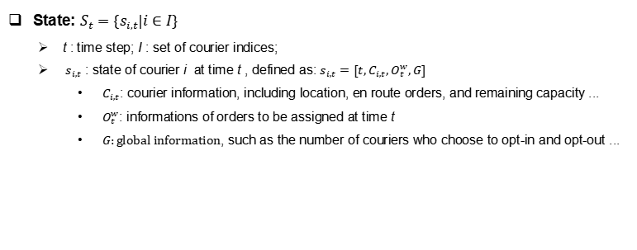
Model for Platform: MDP
State: $S_{t}=\{s_{i,t}|i∈I\}$
t : time step; I : set of courier indices;
$s_{i,t}$ : state of courier i at time t , defined as: $s_{i,t}=[t,C_{i,t},O_{t}^{w},G]$
$C_{i,t}$: courier information, including location, en route orders, and remaining capacity ...
$O_{t}^{w}$: informations of orders to be assigned at time t
$G:global information$, such as the number of couriers who choose to opt-in and opt-out ...

Slide 9
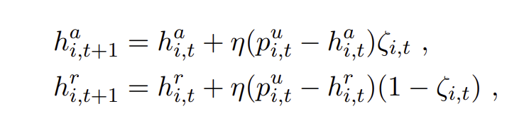
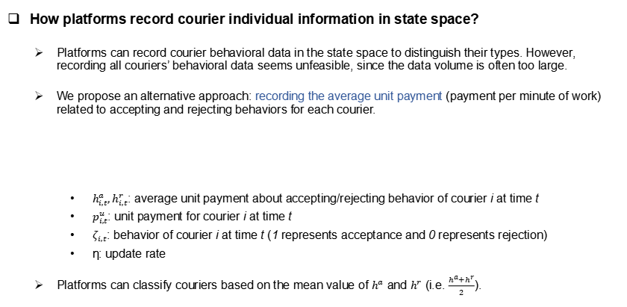
Model for Platform: MDP
How platforms record courier individual information in state space?
Platforms can record courier behavioral data in the state space to distinguish their types. However, recording all couriers’ behavioral data seems unfeasible, since the data volume is often too large.
We propose an alternative approach: recording the average unit payment (payment per minute of work) related to accepting and rejecting behaviors for each courier.
$h_{i,t}^{a},h_{i,t}^{r}$: average unit payment about accepting/rejecting behavior of courier i at time t
$p_{i,t}^{u}$: unit payment for courier i at time t
$ζ_{i,t}$: behavior of courier i at time t (1 represents acceptance and 0 represents rejection)
η: update rate
Platforms can classify couriers based on the mean value of $h^{a}$ and $h^{r}$ (i.e. $\frac{h^{a}+h^{r}}{2}$).

Slide 10
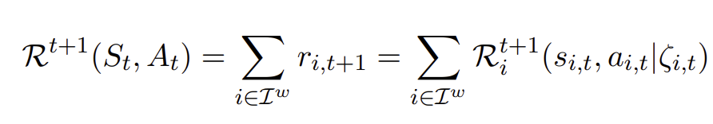
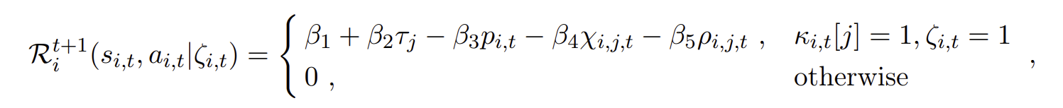
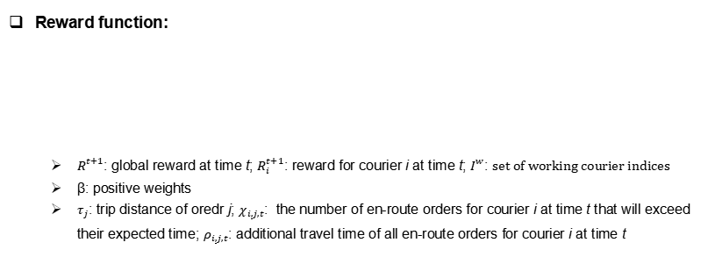
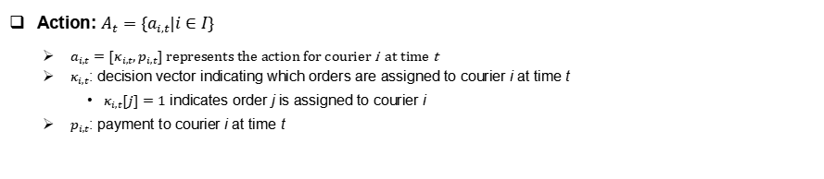
Model for Platform: MDP
Action: $A_{t}=\{a_{i,t}|i∈I\}$
$a_{i,t}=[κ_{i,t},p_{i,t}]$ represents the action for courier i at time t
$κ_{i,t}$: decision vector indicating which orders are assigned to courier i at time t
$κ_{i,t}[j]=1$ indicates order j is assigned to courier i
$p_{i,t}$: payment to courier i at time t
Reward function:
$R_{ }^{t+1}$: global reward at time t; $R_{i}^{t+1}$: reward for courier i at time t; $I_{ }^{w}$: set of working courier indices
β: positive weights
$τ_{j}$: trip distance of oredr j; $χ_{i,j,t}$: the number of en-route orders for courier i at time t that will exceed their expected time;$ρ_{i,j,t}$: additional travel time of all en-route orders for courier i at time t

Slide 11
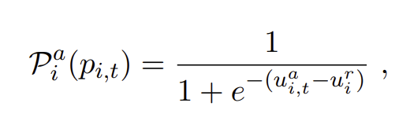
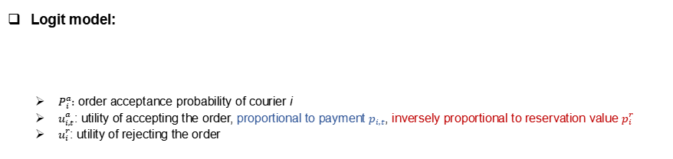
Model for Couriers: Logit Model
Logit model:
$P_{i}^{a}:$ order acceptance probability of courier i
$u_{i,t}^{a}$: utility of accepting the order, proportional to payment $p_{i,t}$, inversely proportional to reservation value $p_{i}^{r}$
$u_{i}^{r}$: utility of rejecting the order

Slide 12
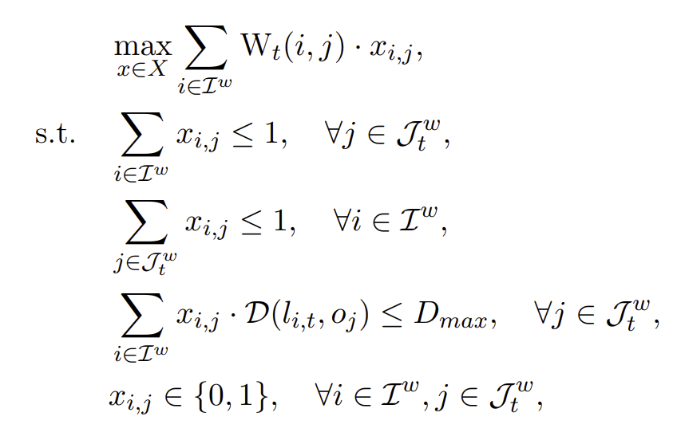
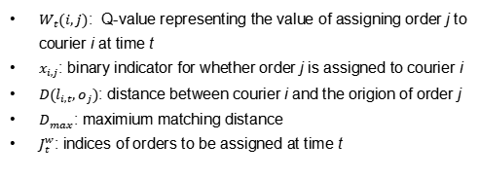
Solution Methodology for MDP of Platform
DDQN for order assignment:
Summary: A neural network is employed to estimate the long-term reward (Q-value) for each courier selecting each order at each time step.
Utilization: Find the optimal dispatching strategy to maximize the global Q-value (long-term reward) at each step through bipartite matching.
Training: gradient descent to minimize Temporal Difference (TD) error
$W_{t}(i,j)$: Q-value representing the value of assigning order j to courier i at time t
$x_{i,j}$: binary indicator for whether order j is assigned to courier i
$D(l_{i,t},o_{j})$: distance between courier i and the origion of order j
$D_{max}$: maximium matching distance
$J_{t}^{w}$: indices of orders to be assigned at time t

Slide 13
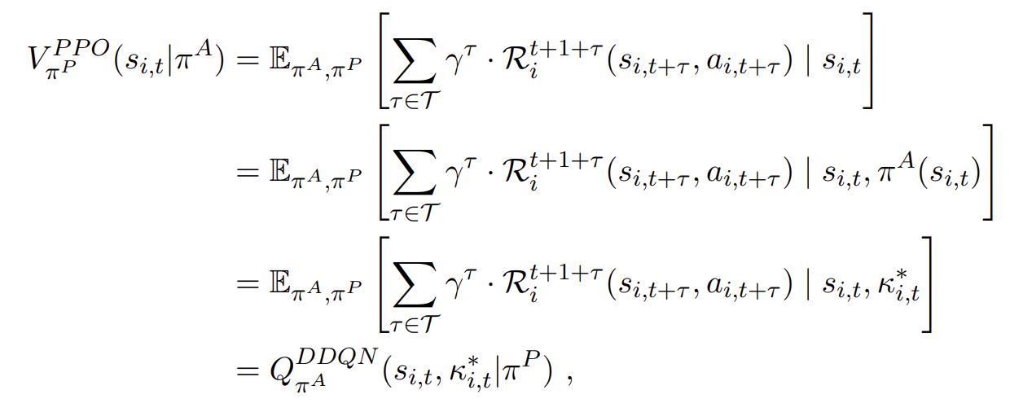
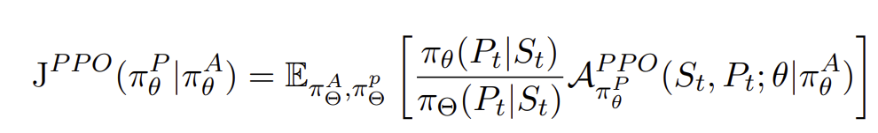
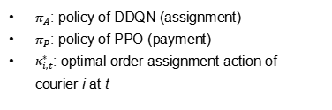
Solution Methodology for MDP of Platform
PPO for payment setting:
Summary: An actor network is employed to directly generate payments for each courier, while a critic network estimates the V-value to guide the updating of the critic network.
Finding: In our scenario, the PPO can directly utilize the Q-network of DDQN as the critic network.
Training of actor: policy gradient to maximize the objective function
$π_{A}$: policy of DDQN (assignment)
$π_{P}:$ policy of PPO (payment)
$κ_{i,t}^{∗}$: optimal order assignment action of courier i at t

Slide 14
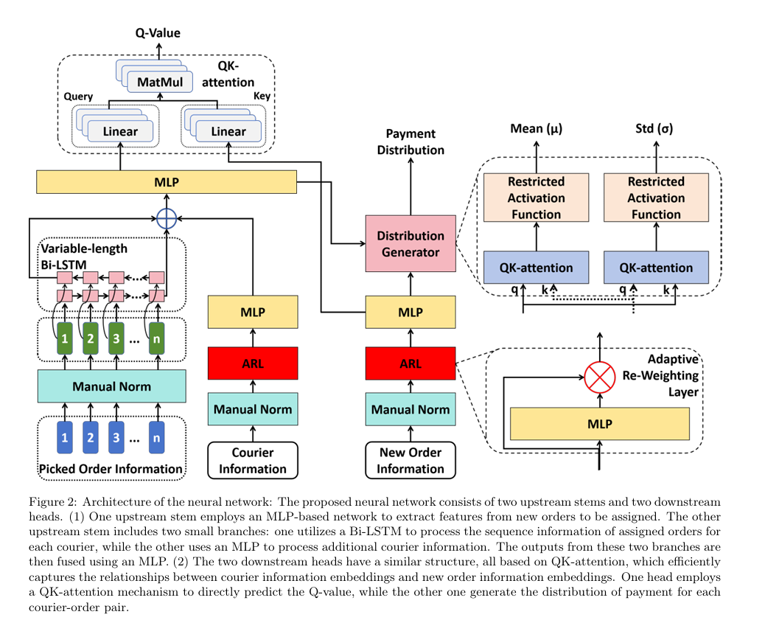
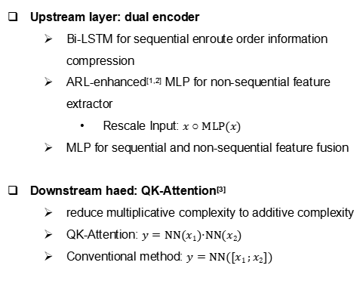
Neural Network Architecture
Upstream layer: dual encoder
Bi-LSTM for sequential enroute order information compression
ARL-enhanced^{[1,2]} MLP for non-sequential feature extractor
Rescale Input: $x ○ MLP(x)$
MLP for sequential and non-sequential feature fusion
Downstream haed: QK-Attention^{[3]}
reduce multiplicative complexity to additive complexity
QK-Attention: $y=NN(x1)·NN(x2)$
Conventional method: $y=NN([x1 ;x2])$
[1] Chen T, Wang Y, Chen H, et al. Modelling the 5g energy consumption using real-world data: Energy fingerprint is all you need[C]//2025 IEEE Globecom Workshops (GC Wkshps). IEEE, 2025: 1-6.
[2] Zhao Z, Meng F, Lyu Z, et al. Csi-bert2: A bert-inspired framework for efficient csi prediction and classification in wireless communication and sensing[J]. arXiv preprint arXiv:2412.06861, 2024.
[3] Zhao Z, Chen T, Cai Z, et al. Crossfi: A cross domain wi-fi sensing framework based on siamese network[J]. IEEE Internet of Things Journal, 2025.

Slide 15
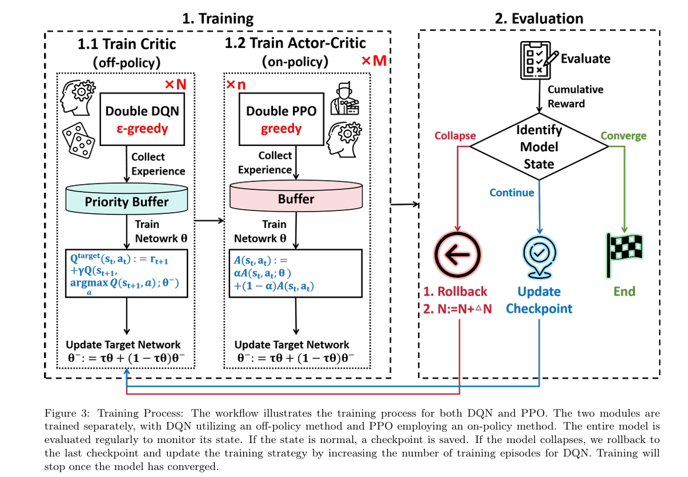
Alternative Training with Rollback Mechanism
Alternative training strategy
Training DQN and PPO simultaneously can be unstable. It's difficult to determine whether changes in rewards result from one's own actions or those of the other algorithm.
Rollback mechanism
At times, the PPO policy may collapse due to the critic (DQN) not aligning with updates from the actor.
When a collapse occurs, we
roll back to the last checkpoint
reduce the frequency of PPO training updates

Slide 16
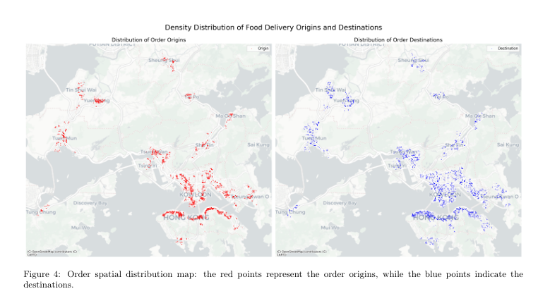
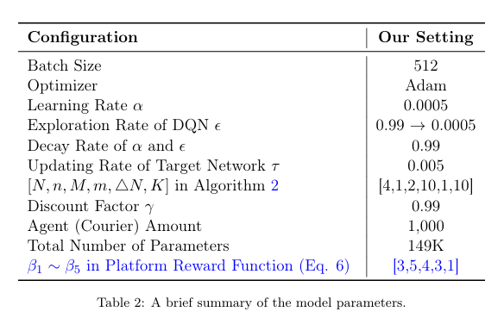
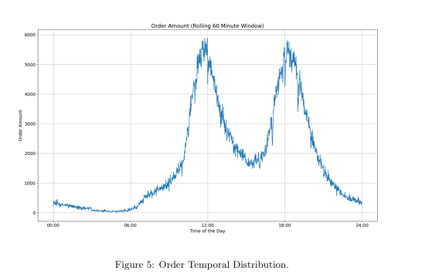
Case Studies
Food delivery in Hong Kong, China

Slide 17
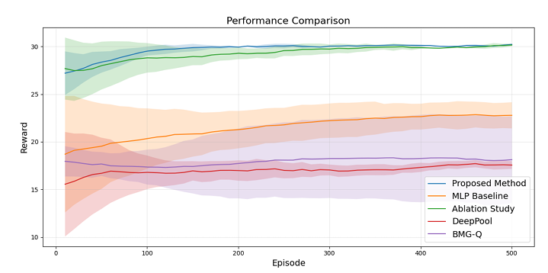
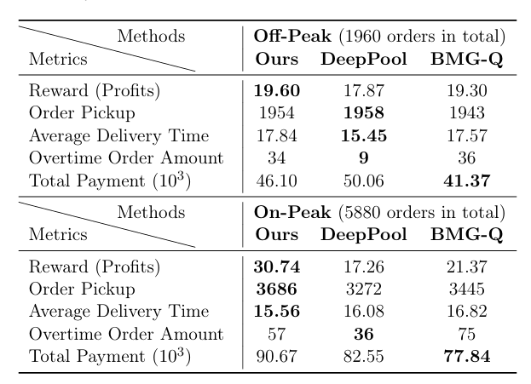
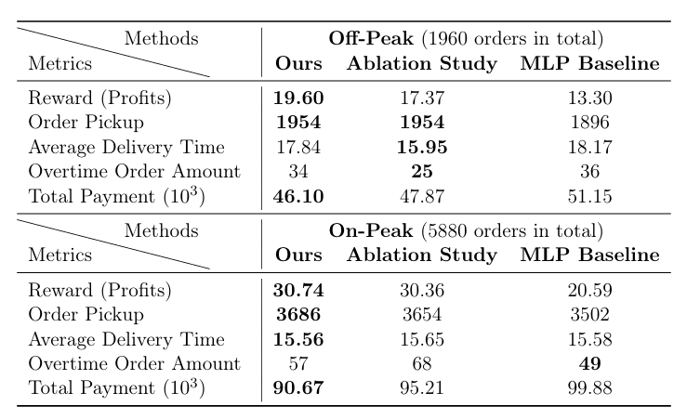
Case Studies
Performance comparison

Slide 18
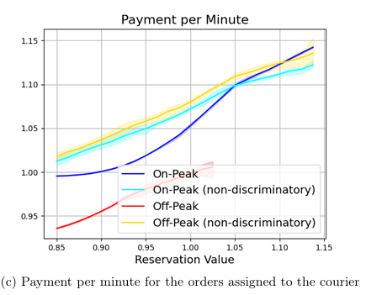
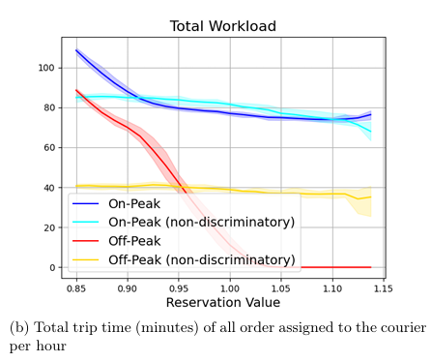
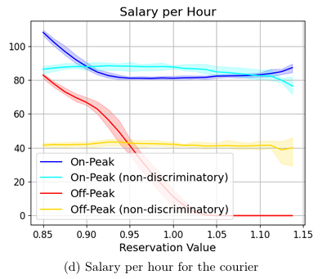
Case Studies
Comparison between discriminatory algorithm and non-discriminatory algorithm
How platforms discriminate different types of couriers？
Higher reservation couriers receive:
higher unit payments
lower workloads
lower total earnings

Slide 19
Part III: Courier Modeling via MA-CMAB
Zijian Zhao, Sen Li*, "The Impacts of Data Privacy Regulations on Food-Delivery Platforms", Transportation Research Part C: Emerging Technologies (TR_C), 2025

Slide 20
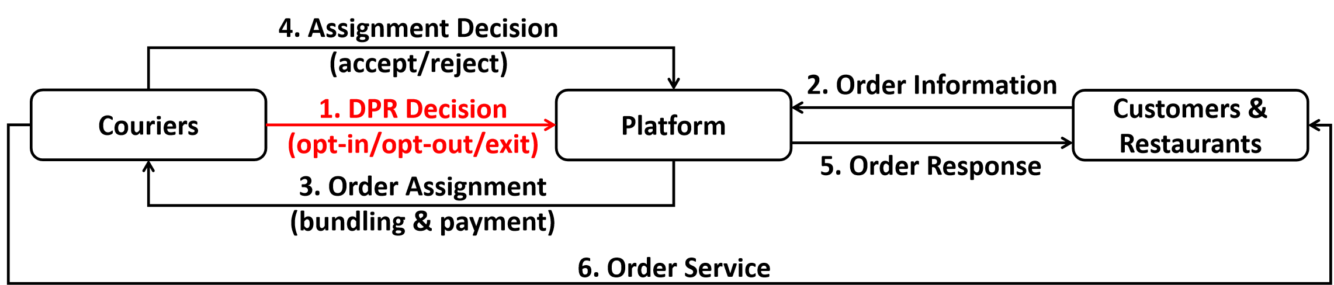
System Workflow
Platform：determine order assignment and payment setting
Couriers：
long-term: choose from opt-in (work with providing personal information), opt-out (work without providing personal information), or exit (do not work) at the beginning of each time period
short-term: determine whether to accept the assigned order based on payment and individual reservation value
Customers & Restaurants:
set orders at arbitrary times
cancel the order if not confirmed within a maximium time threshold

Slide 21
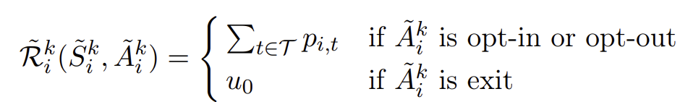
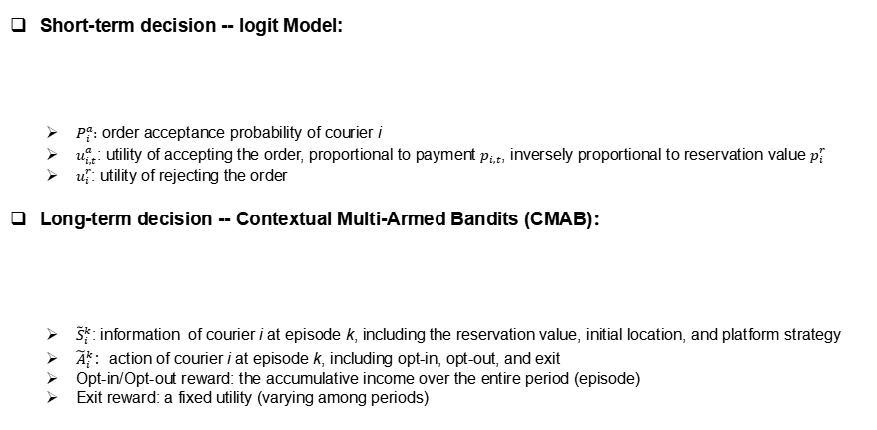
Model for Couriers: Logit Model & CMAB
Short-term decision -- logit Model:
$P_{i}^{a}:$ order acceptance probability of courier i
$u_{i,t}^{a}$: utility of accepting the order, proportional to payment $p_{i,t}$, inversely proportional to reservation value $p_{i}^{r}$
$u_{i}^{r}$: utility of rejecting the order
Long-term decision -- Contextual Multi-Armed Bandits (CMAB)：
${\tilde{S}}_{i}^{k}$: information of courier i at episode k, including the reservation value, initial location, and platform strategy
${\tilde{A}}_{i}^{k}$：action of courier i at episode k, including opt-in, opt-out, and exit
Opt-in/Opt-out reward: the accumulative income over the entire period (episode)
Exit reward: a fixed utility (varying among periods)

Slide 22
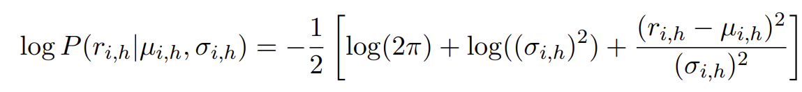
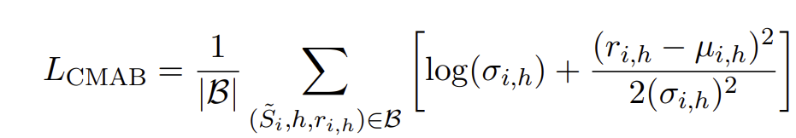
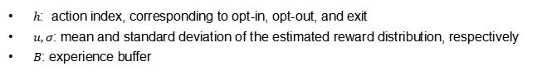
Solution Methodology for CMAB of Couriers
Thompson sampling method:
Summary: Utilize a neural network to estimate the reward distribution for each action within a given state.
Utilization: Select the action with the highest sampled reward.
Training: Model the reward distribution as a Gaussian distribution and train the network using Maximum Likelihood Estimation (MLE).
$h$: action index, corresponding to opt-in, opt-out, and exit
$u,σ$: mean and standard deviation of the estimated reward distribution, respectively
$B$: experience buffer

Slide 23
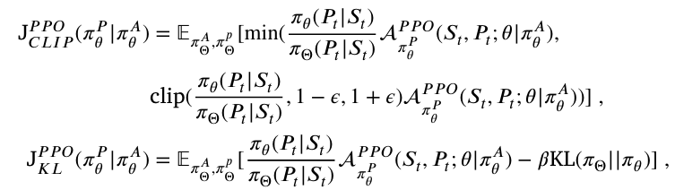
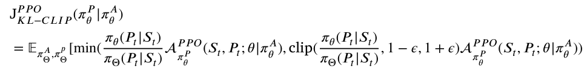
PPO-KL-CLIP for Platform Payment Setting
Original PPO —— unstable chanllenge^{[4,5]}:
PPO-CLIP: If new policy θ have already deviated original policy Θ significantly, the gradient becomes 0, preventing the policy from recovering.
PPO-KL: The performance can be influenced by β significantly, necessitating a balance between KL-restriction and policy updates.
Our solution: PPO-KL-CLIP
inspired by GRPO^{[6]}
add KL normalization to PPO-CLIP, helping recover the deviated policy.
[4] Hsu C C Y, Mendler-Dünner C, Hardt M. Revisiting design choices in proximal policy optimization[J]. arXiv preprint arXiv:2009.10897, 2020.
[5] Engstrom L, Ilyas A, Santurkar S, et al. Implementation Matters in Deep Policy Gradients: A Case Study on PPO and TRPO[C]//International Conference on Learning Representations. 2020.
[6]Shao Z, Wang P, Zhu Q, et al. Deepseekmath: Pushing the limits of mathematical reasoning in open language models[J]. arXiv preprint arXiv:2402.03300, 2024.

Slide 24
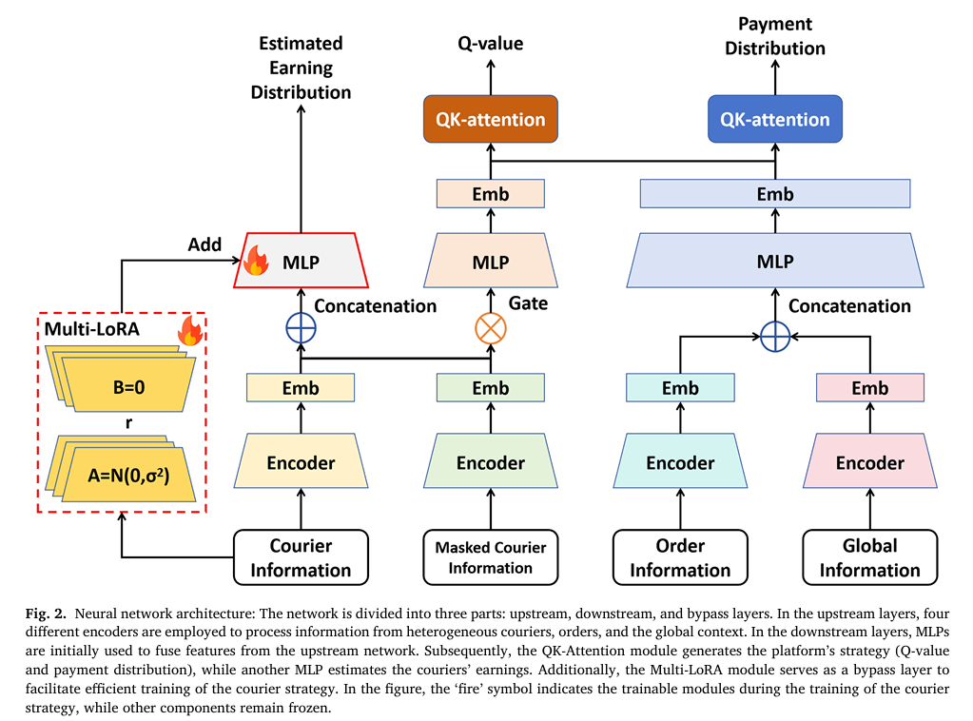
Neural Network Architecture
Shared heterogeneous encoder
shared structure enhances the extraction of robust features
heterogeneous structure facilitates simultaneous processing of opt-in and opt-out couriers.
Triple decision heads
for payment setting, order assignment, and courier long-term choice, respectively
Multi-LoRA for couriers CMAB
shared encoder enables couriers to understand the platform's strategy
multiple lora prevents homogenous strategies among couriers, promoting diverse decision-making

Slide 25
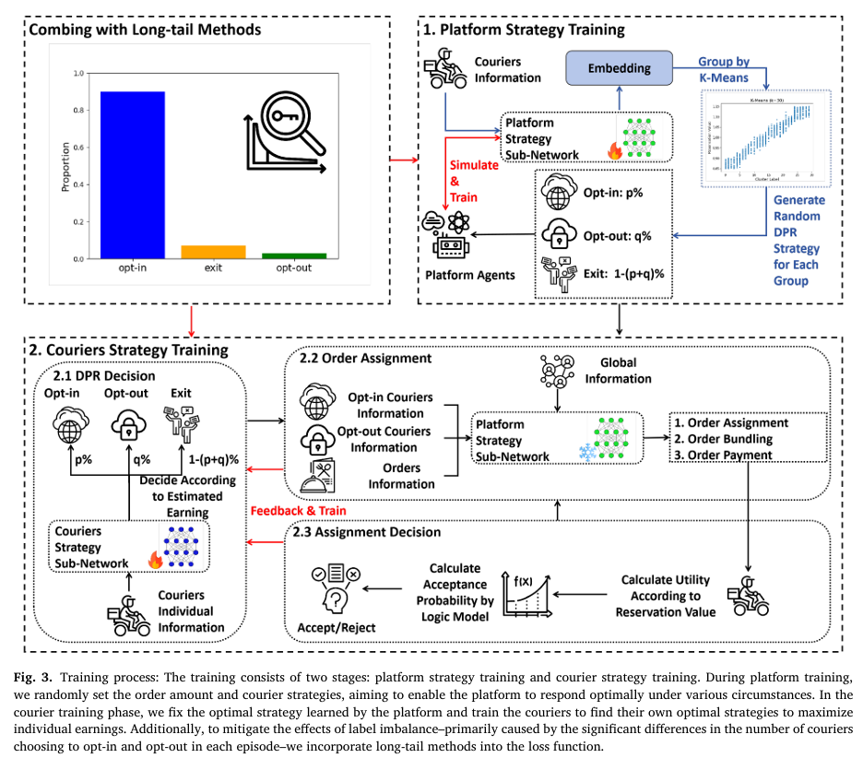
Training Process
Phase1: platform training
train an adaptive policy that optimally responds to all possible decisions made by couriers
Phase2: couriers rraining
given the fixed well-trained platform strategy, train couriers to identify the optimal long-term decisions aimed at maximizing cumulative earnings

Slide 26
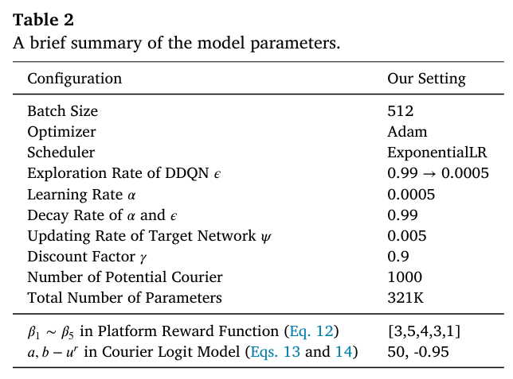
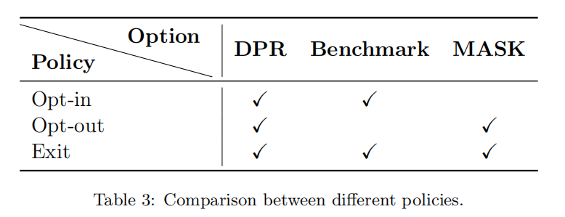
Case Studies
Food delivery in Hong Kong, China
Comparative policies

Slide 27
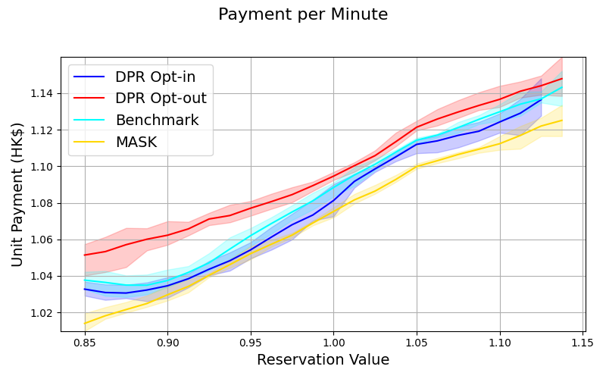
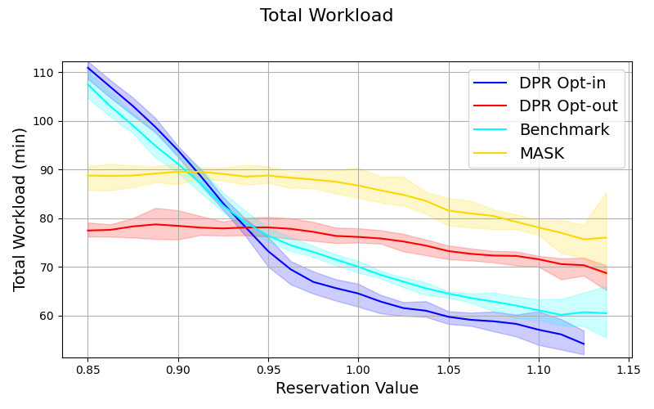
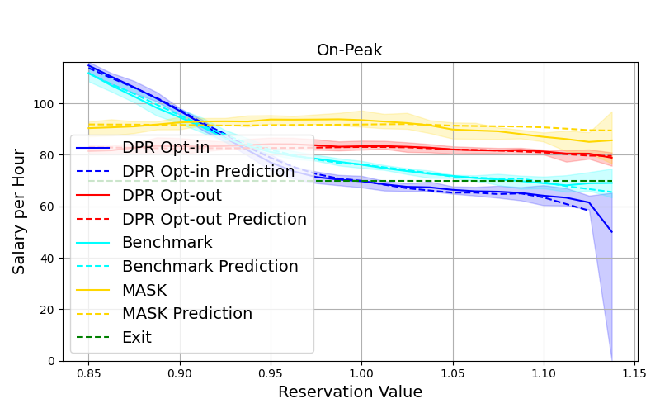
Case Studies
Unit Payment (payment per minute)
Total Workload (measured by time)
Total Earning (whole preiod)
How platforms discriminate different types of couriers？
For opt-in couriers (blue curves): Higher reservation couriers receive:
higher unit payments
lower workloads
lower total earnings
For opt-out couriers (red curves): Higher reservation couriers experience:
higher unit payments
slightly lower workloads
similar earnings compaerd to low reservation couriers

Slide 28
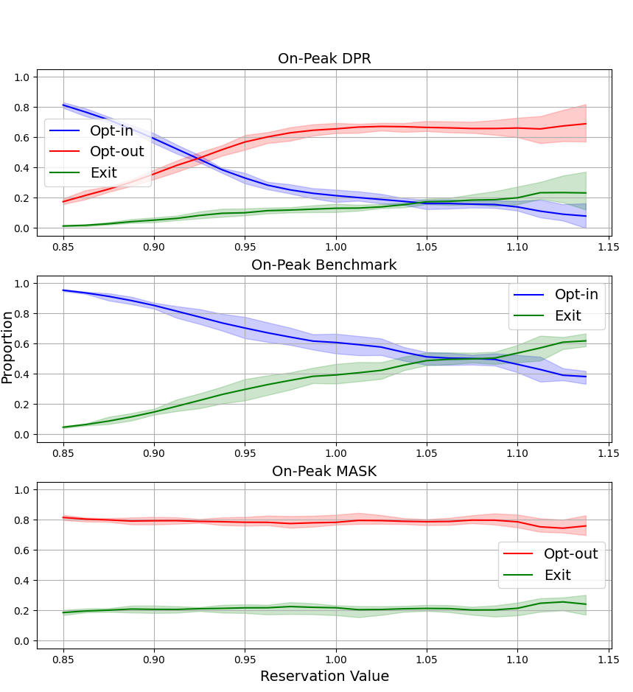
Case Studies
How DPR affects couriers behavior？
More couriers are attracted to choose opt-out option on the platform, leading to a lower exiting rate.
DPR effectively protects the rights of high-reservation couriers, allowing them to choose opt out to access more work opportunities.
Proportion of Choices Among Couriers

Slide 29
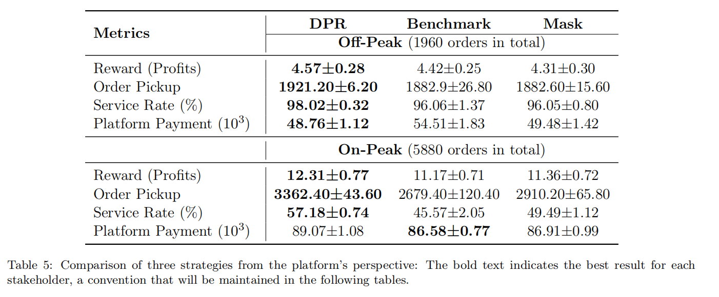
Case Studies
How DPR affects platform profits？
The platform gets higher profits since the increased number of active couriers helps fulfill more orders.

Slide 30
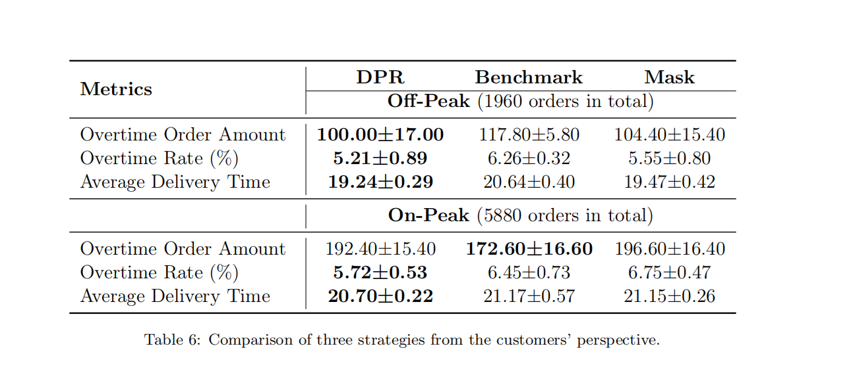
Case Studies
How DPR affects customers satisfication？
Customers get better experience due to the increased number of active couriers, which allows the platform to optimize planning better, leading to a lower order delivery times.

Slide 31
oi
Part IV: Future Works

Slide 32
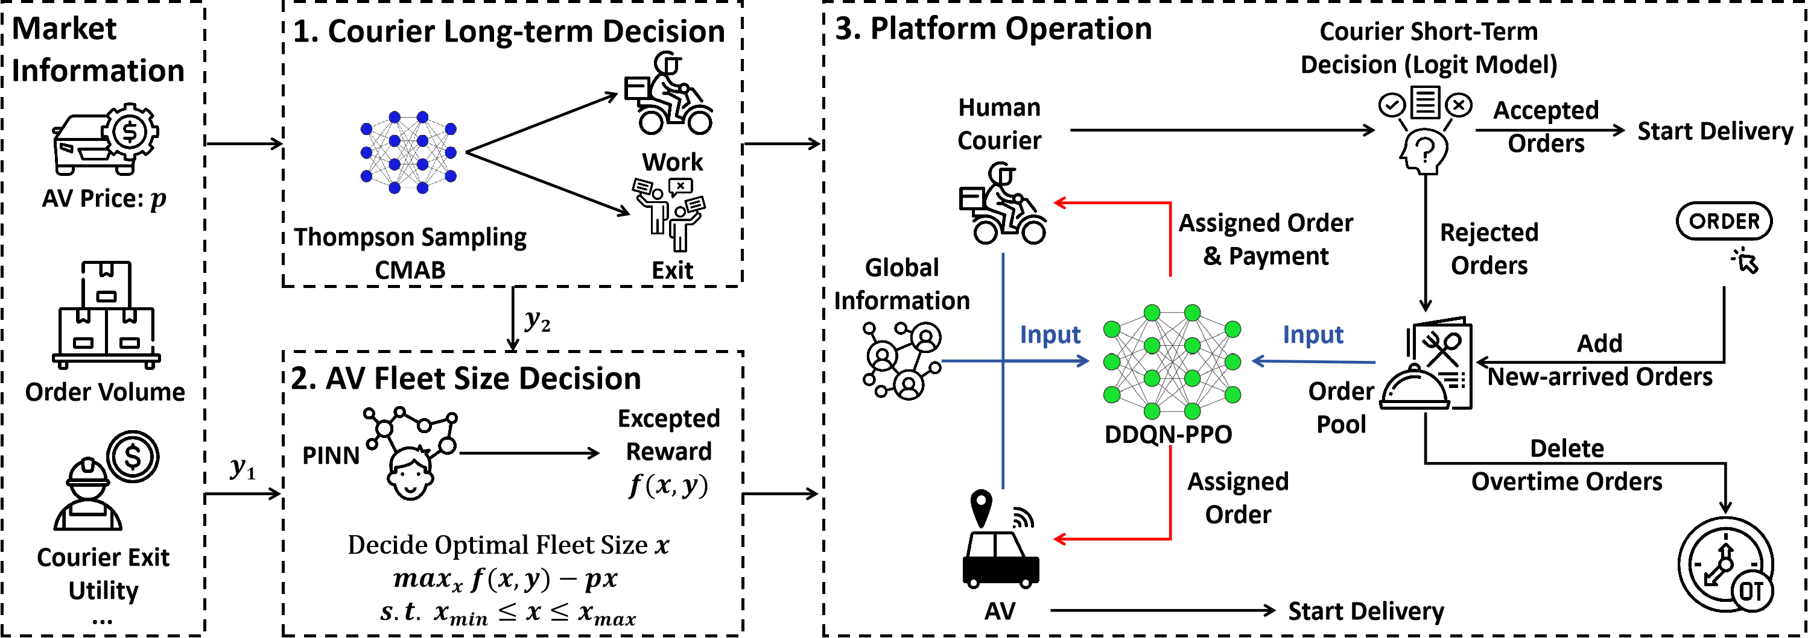
Future Works
Impact of AV in discriminatory food delivery platform ^{[7]}
How to determine optimal AV fleet size?
What’s the impact of AV to human couriers?
How might the spatial distribution differ between AVs and human couriers?
[7] Ye A, Zhang K, Bell M G H, et al. Modeling an on-demand meal delivery system with human couriers and autonomous vehicles in a spatial market[J]. Transportation Research Part C: Emerging Technologies, 2024, 168: 104723.

Slide 33
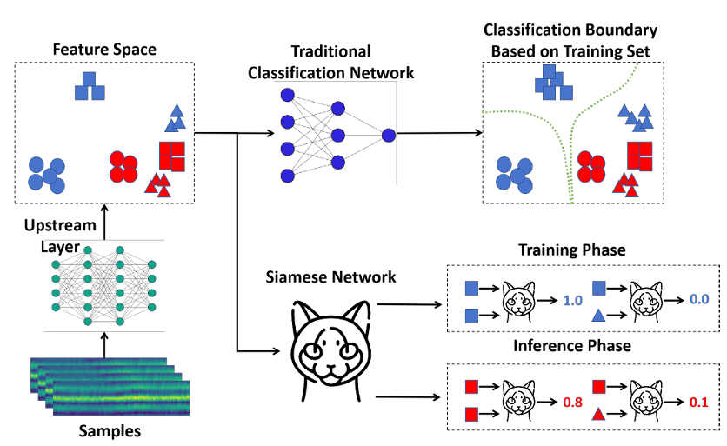
Future Works
Cross-domain challenge in transportation
domain shift in Offline-to-Online (O2O) RL ^{[8]}
traffic prediction task in cross-domain scenario (cross region & cross time ...) ^{[9]}
[8] Ye A, Zhang K, Bell M G H, et al. Modeling an on-demand meal delivery system with human couriers and autonomous vehicles in a spatial market[J]. Transportation Research Part C: Emerging Technologies, 2024, 168: 104723.
[9] Ma J, Wu F. Effective traffic signal control with offline-to-online reinforcement learning[C]//2023 IEEE/RSJ International Conference on Intelligent Robots and Systems (IROS). IEEE, 2023: 1-7.

Slide 34

Future Works
LLM & Transportation
LLM4Transportation^{[10]}: LLM-assisted decision (LLM as encoder & LLM as planner)
Transportation Foundation Model^{[11]}: inject transportation knowledge into LLM (RAG, SFT, RL post-training)
[10] Lyu T, Feng S, Liu H, et al. LLM-ODDR: A Large Language Model Framework for Joint Order Dispatching and Driver Repositioning[J]. arXiv preprint arXiv:2505.22695, 2025.
[11] Wang J, Dong Z, Bai B, et al. FoodGPT: Reinforcement Post-Training of Large Language Models in the Food Delivery Domain[C]//Proceedings of the 31st ACM SIGKDD Conference on Knowledge Discovery and Data Mining V. 2. 2025: 4966-4974.

Slide 35
oi
Part V: Conclusion

Slide 36
Concluding Remarks
Project 1: Algorithm discrimination of food delivery platform
Developed a Hybrid-Action MARL framework to model platform behavior.
Proposed a novel network structure and training strategy for effective policy training.
Simulation results indicate the platform favors low-reservation couriers by offering more work opportunities.
Project 2: Impact of data privacy regulation to food delivery market
Developed a CMAB framework to model the long-term behavior of couriers under DPR.
Introduced MLE-based Thompson Sampling, PPO-KL-CLIP, and a multi-stage training process as methodological solutions.
Simulation findings demonstrate that DPR fosters a win-win scenario for platforms, couriers, and customers.

Slide 37
Publication List
Journal
Zijian Zhao, Sen Li*, "The Impacts of Data Privacy Regulations on Food-Delivery Platforms", Transportation Research Part C: Emerging Technologies (TR_C), 2025
Zijian Zhao, Sen Li*, "Discriminatory Order Assignment and Payment-Setting of On-Demand Food-Delivery Platforms: A Multi-Action and Multi-Agent Reinforcement Learning Framework" (under thrid-round review, Transportation Research Part E: Logistics and Transportation Review (TR_E))
Zijian Zhao, Sen Li*, "The Impacts of Automatic Vehicle on Discriminatory Food Delivery Platform: A Multi-Stage Framework via Hybrid Learning Technologies" (in preparation)
Conference
Zijian Zhao, "Towards Fairness in Transportation Gig Markets: Identifying, Imitating, and Mitigating Algorithm Discrimination via Deep Reinforcement Learning", 2026 Annual AAAI Conference on Artificial Intelligence (AAAI) / Special Interest Group on Artificial Intelligence (SIGAI) Doctoral Consortium, 2026
Zijian Zhao, Jing Gao*, Sen Li, "Ride-Hailing Order Dispatching with A Mixture of On-Demand and Pre-Booked Requests via Reinforcement Learning", 2026 COTA International Conference of Transportation Professionals (CICTP), 2026
Zijian Zhao, Sen Li*, "Multi-Agent Reinforcement Learning for Order Assignment and Payment Setting on Food-Delivery Platforms: The Implicit Algorithmic Biases", 2025 International Symposium on Transportation Data & Modelling (ISTDM), 2025
Zijian Zhao, Sen Li*, "Triple-BERT: Do We Really Need MARL for Ride-Sharing Order Dispatch?" (under review, 2026 International Conference on Learning Representations (ICLR))
Zijian Zhao, Sen Li*, "One Step is Enough: Multi-Agent Reinforcement Learning Based on One-Step Policy Optimization for Order Dispatch on Ride-Sharing Platforms" (under revision, to be submitted to 2026 International Conference on Machine Learning (ICML))
Zijian Zhao, Yitong Shang, Sen Li*, "AutoFed: A Personalized Federated Travel Demand Prediction Framework via Global Representation" (in preparation, to be submitted to 2026 International Conference on Machine Learning (ICML))

Slide 38
Thanks for your attention!
Presented by Zijian Zhao
zzhaock@connect.ust.hk

Slide 39



Case Studies
Comparison between crowdsourced-only market and mixed market
What if we further introduce fixed-contract couriers?
Fixed-contract couriers receive the highest preference.
Crowdsourced couriers get less workload and earning.

